Slide 1
Spectral Clustering
Very often outperforms traditional clustering algorithms such as the k-means algorithm.(Why)
It is simple to implement, can be solved efficiently by standard linear algebra software (eigen vectors)
Graph-> similarity graphs

Slide 2
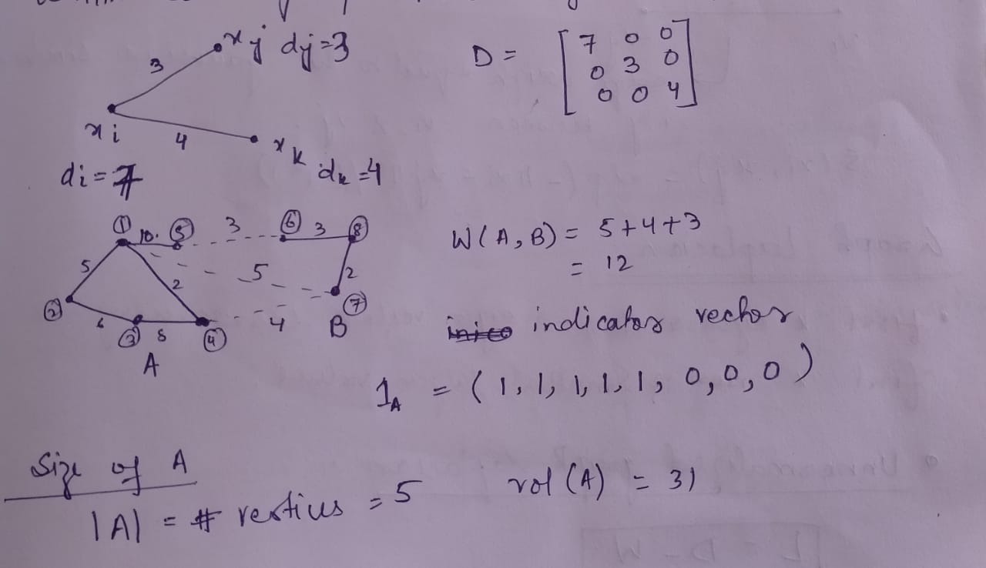
Similarity graphs
Undirected and weighted
Important terms

Slide 3
Different similarity graphs
The ε-neighbourhood graph
K-nearest neighbour graphs (how to make undirected)
The fully connected graph
(Gaussian similarity function s(xi, xj ) = exp(− xi − xj 2/(2σ2))

Slide 4
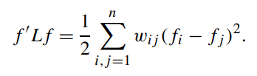
The unnormalized graph Laplacian
L = D − W
For every vector f ∈ R ->
L is symmetric and positive semi-definite.
The smallest eigenvalue of l is 0, the corresponding eigenvector is the constant one vector 1.
L has n non-negative, real-valued eigenvalues 0 = λ1 ≤ λ2 ≤···≤ λn

Slide 5
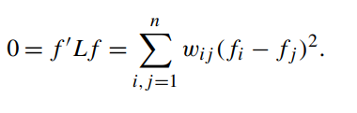
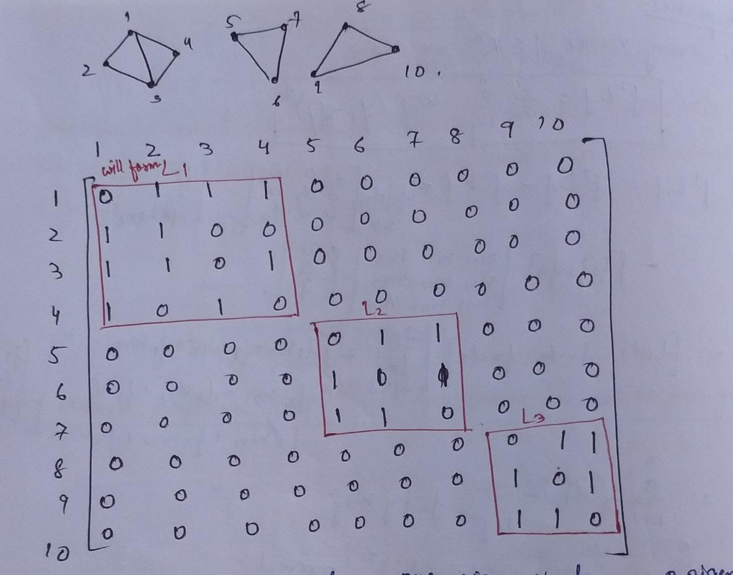
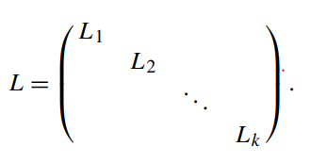
Let G be an undirected graph with nonnegative weights. Then the multiplicity k of the eigenvalue 0 of L equals the number of connected components A1,...,Ak in the graph.

Slide 6
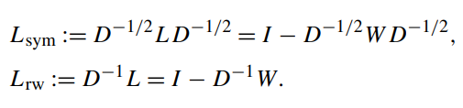
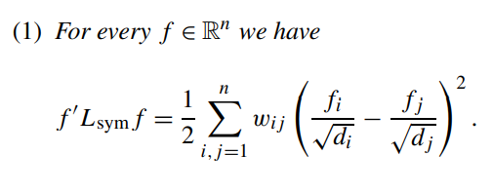
The normalized graph Laplacians

Slide 7
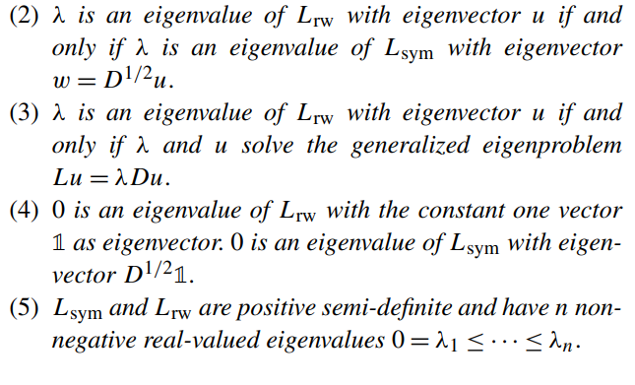
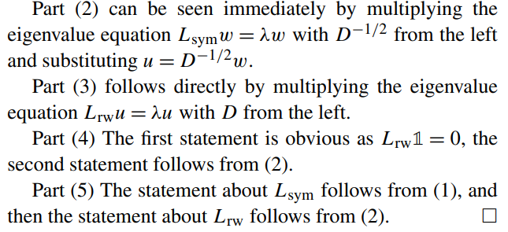

Slide 8
Let G be an undirected graph with non-negative weights. Then the multiplicity k of the eigenvalue 0 of both Lrw and Lsym equals to the number of connected components A1,...,Ak in the graph

Slide 9
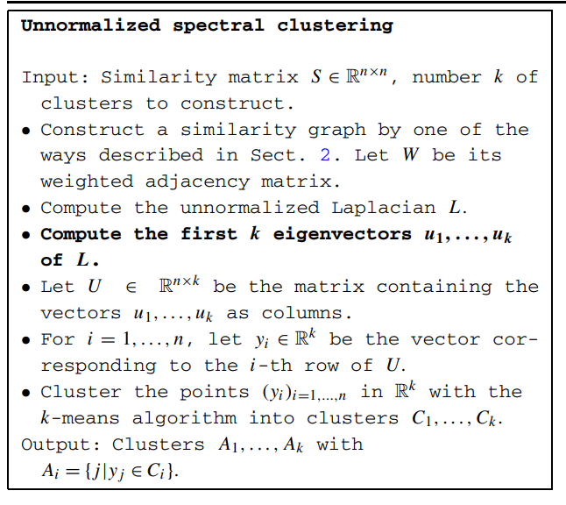

Slide 10
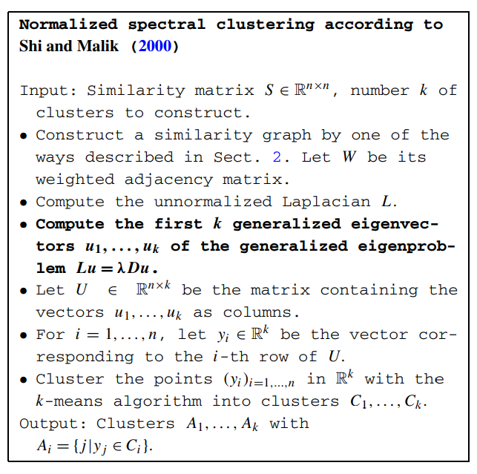
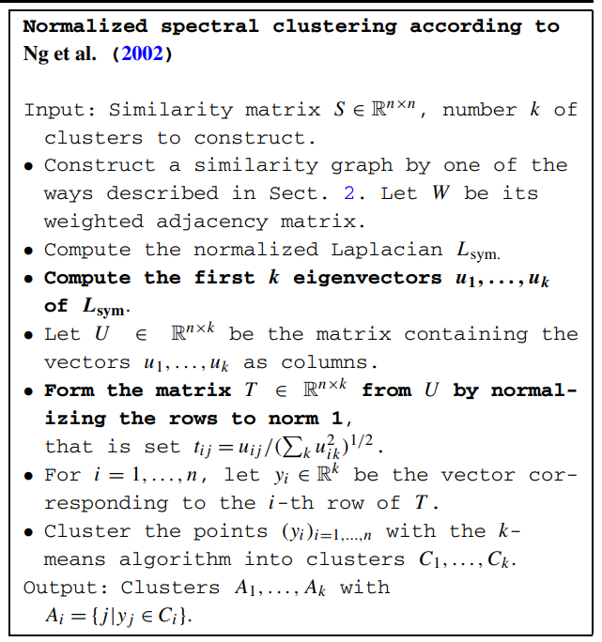

Slide 11
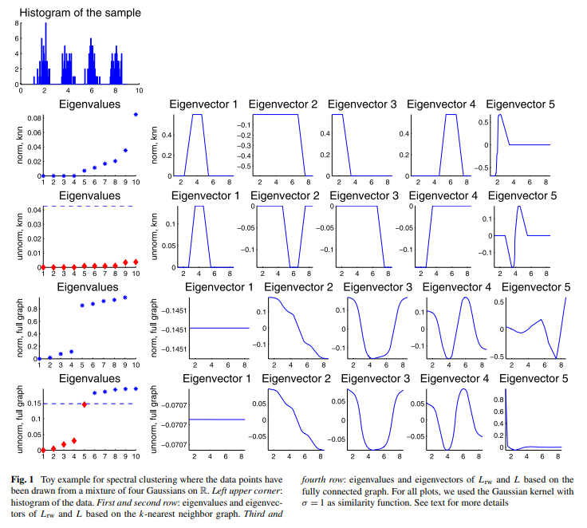

Slide 12
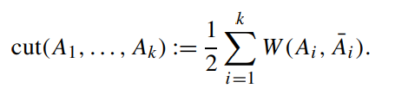
spectral clustering can be derived as an approximation to graph partitioning problems
We want to find a partition of the graph such that the edges between different groups have a very low weight (which means that points in different clusters are dissimilar from each other) and the edges within a group have high weight (which means that points within the same cluster are similar to each other)
Choosing a partition a1,...,Ak which minimizes

Slide 13
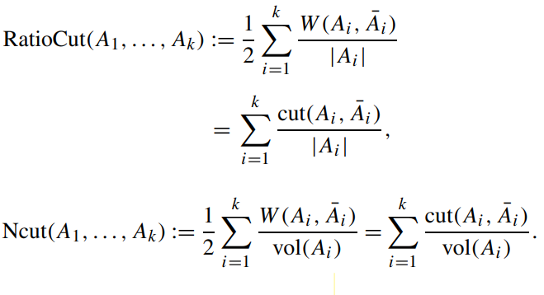
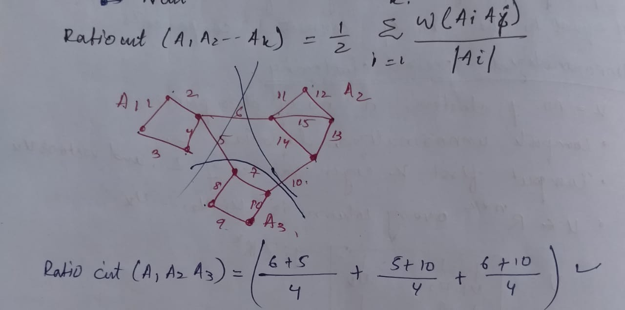
Both objective functions take a small value if the clusters Ai are not too small.
An NP hard problem

Slide 14
We will see that relaxing Ncut leads to normalized spectral clustering, while relaxing RatioCut leads to unnormalized spectral clustering

Slide 15

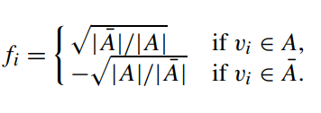
Approximating RatioCut for k = 2
We first rewrite the problem in a more convenient form.

Slide 16
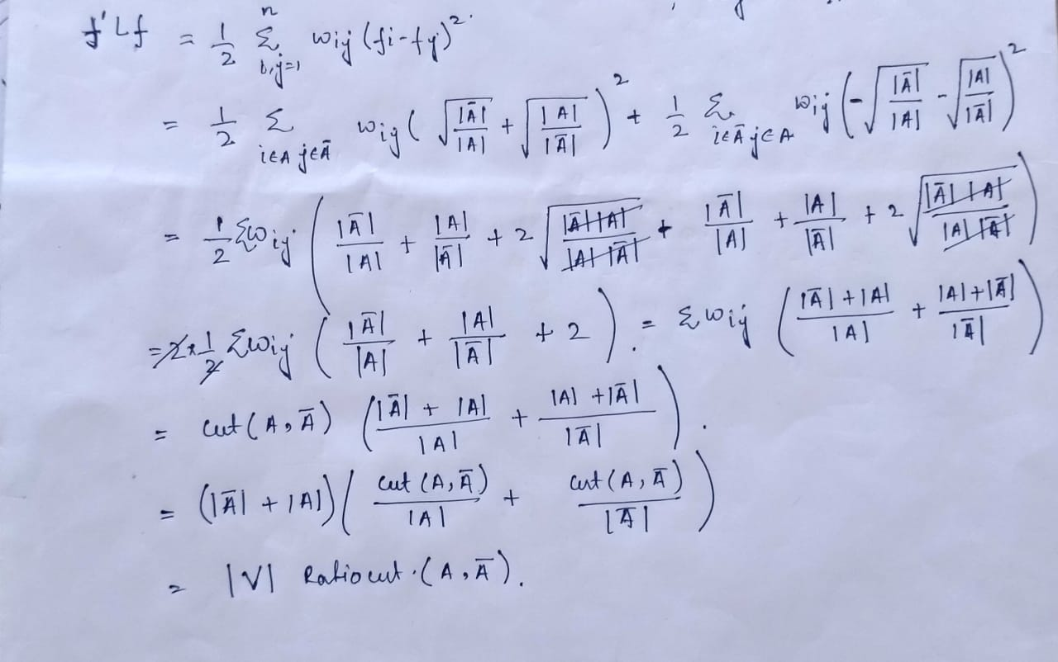

Slide 17
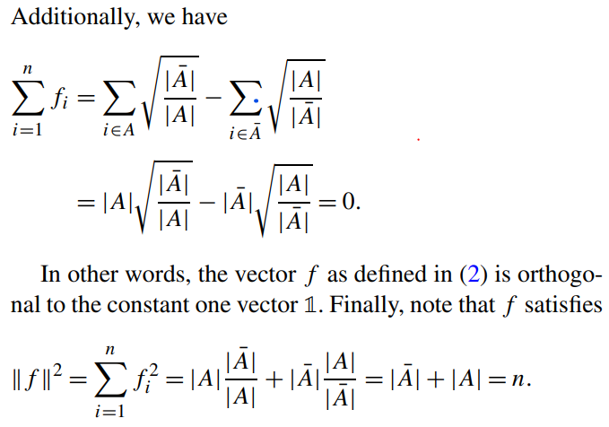
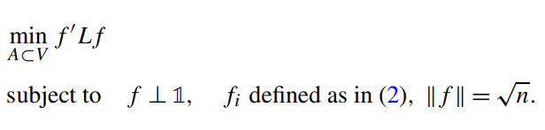
The problem can be equivalently rewritten as

Slide 18

Still an NP complete problem
Relaxation in this setting is to discard the discreteness condition and instead allow fi to take arbitrary values in R. This leads to the relaxed optimization problem

Slide 19
The solution of this problem is given by the vector f which is the eigenvector corresponding to the second smallest eigenvalue of L. So we can approximate a minimizer of RatioCut by the second eigenvector of L

Slide 20

we need to re-transform the real valued solution vector f of the relaxed problem into a discrete indicator vector
This is exactly the unnormalized spectral clustering algorithm for the case of k = 2.

Slide 21
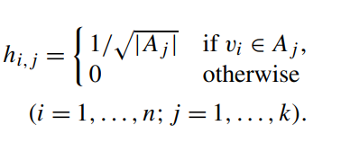
Approximating RatioCut for arbitrary k
Then we set the matrix H ∈ Rn×k as the matrix containing those k indicator vectors as columns. Observe that the columns in H are orthonormal to each other, that is H’H = I .

Slide 22
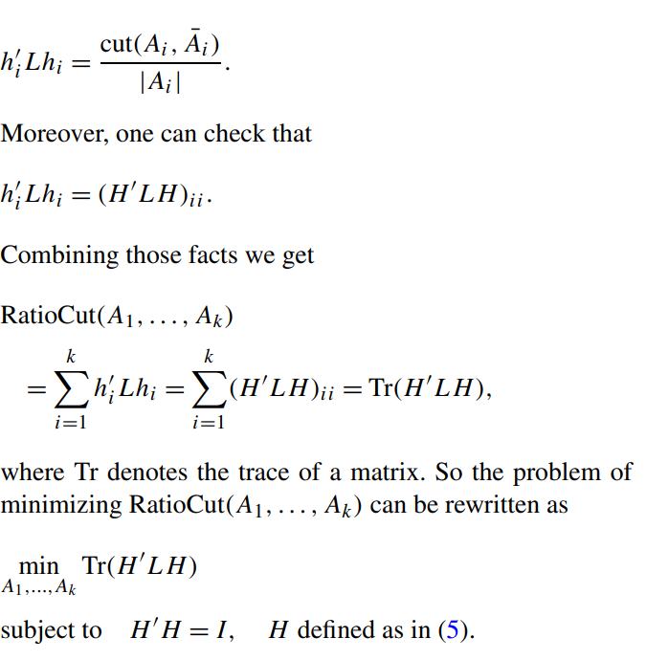

Relaxed form
This is the standard form of a trace minimization problem
The solution is given by choosing H as the matrix which contains the first k eigenvectors of L as columns.
We can see that the matrix H is in fact the matrix U used in the unnormalized spectral clustering algorithm

Slide 23
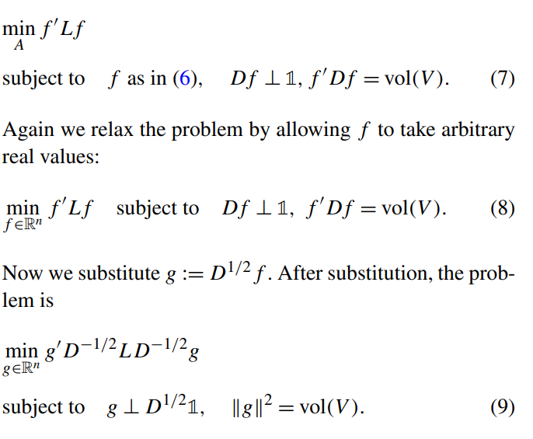
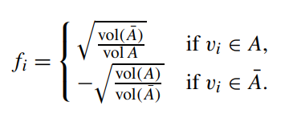
Approximating Ncut
Its solution g is given by the second eigenvector of Lsym

Slide 24
Practical details
The similarity function
Which type of similarity graph(k nearest neighbours as it can break into several disconnected components if there are high density regions which are reasonably far away from each other.)
The parameters of the similarity graph
Computing the eigenvectors
The number of clusters(eigen gap heuristic)
The k-means step
Which graph laplacian should be used?(Regular graph?)
Which normalized laplacian
Consistency issues

